Slide 1


Most
Dominant color recognition
From
Images
DLS Prasanna(6726)
K Shreeya(6719)

Slide 2
contents
Abstract
Introduction
K-means Clustering
Project & Code Implementation
Importing packages
Preprocessing
ML Algorithm
Plotting
Input & Output

Slide 3
abstract
In the realm of computer vision and image processing, the identification of dominant colors within an image plays a pivotal role in numerous applications such as image compression, content-based image retrieval, and color-based segmentation.
The proposed algorithm begins by converting the input image into a suitable format for analysis, typically a three-dimensional array representing pixel values in the RGB color space.

Slide 4
Introduction
Artificial Intelligence is a broad field of computer science that aims to create machines or systems that can perform tasks that would typically require human intelligence.
These tasks include problem-solving, understanding natural language, recognizing patterns, speech recognition, visual perception, and decision-making.

Slide 5
Unsupervised learning
Unsupervised learning is a type of machine learning where the algorithm is given input data without explicit instructions on what to do with it.
No Labeled Input
Exploratory in Nature
Types of unsupervised ml are
Clustering
Dimentionality Reduction
Association

Slide 6
K-MEANS ALGORITHM
K-Means clustering is one of the most popular unsupervised machine learning algorithms used for clustering similar data points into groups or clusters.
The main goal of K-Means clustering is to partition a dataset into 'k' clusters, where each data point belongs to the cluster with the nearest mean (centroid).
Steps:
Initialization:
Choose the number of clusters 'k.'
Randomly initialize the centroids of the 'k' clusters.

Slide 7
2. Assignment:
Assign each data point to the cluster whose centroid is closest to it. The distance metric is typically Euclidean distance.
3. Update Centroids:
Recalculate the centroids of each cluster based on the data points assigned to it.
4. Repeat:
Repeat steps 2 and 3 until convergence (when centroids do not change significantly).

Slide 8
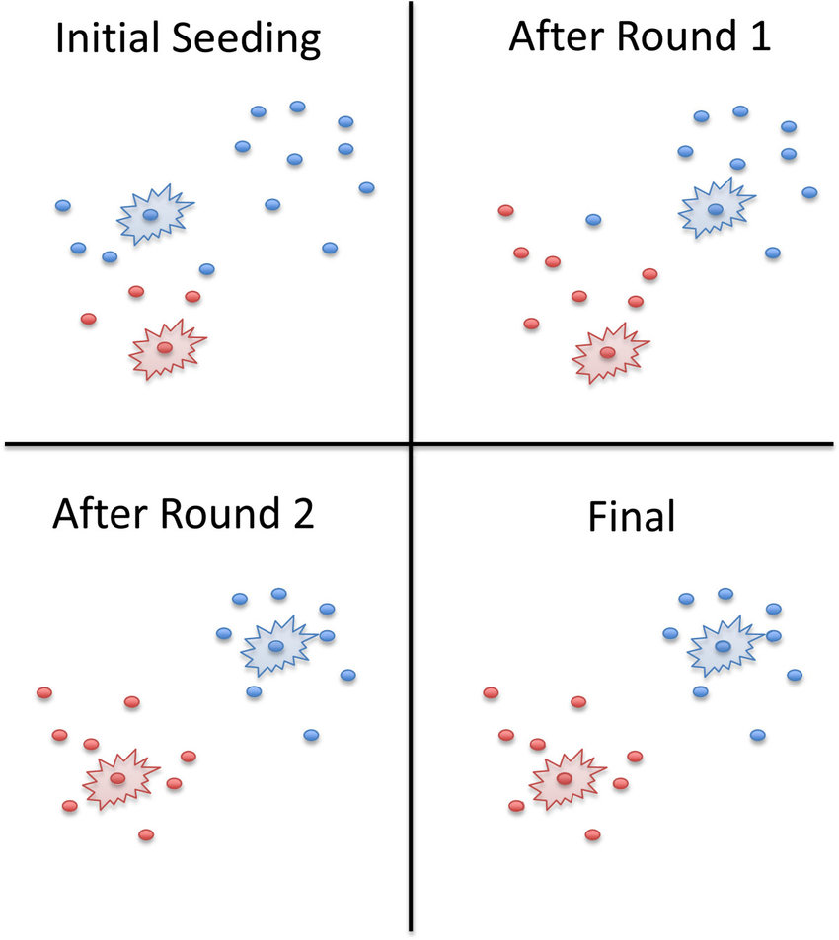

Slide 9
Project & code Implementation
The “Most Dominant Colors Extraction from Images" project aims to develop a system that analyzes an input image and identifies its most dominant colors. This project finds application in image processing, graphic design, and content-based image retrieval, providing valuable insights into the color composition of an image.
It even gives plots of the most dominant colors and their percentages as an output

Slide 10
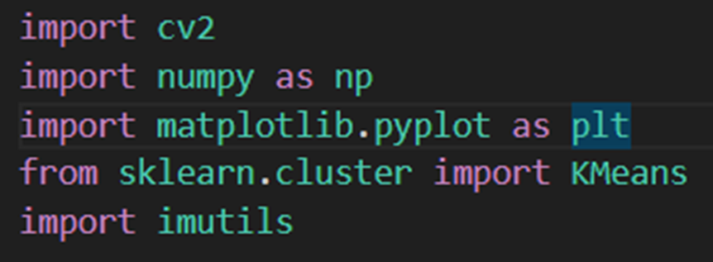
Packages Required
OpenCV (cv2): Open Source Computer Vision Library provides functions for computer vision tasks.
Matplotlib: is a 2D plotting library for Python that produces publication-quality figures in various formats.
Scikit-learn: is a machine learning library for Python that provides simple and efficient tools for data analysis.
Imutils: is a collection of convenience functions for openCV.
NumPy: is a fundamental package for scientific computing in Python.

Slide 11
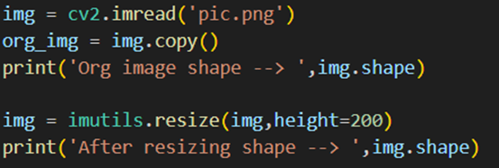

preprocessing
Reads and loads the input image.
Converts the image to a suitable format (e.g., RGB) for analysis.
Flattening the image: we are just keeping all the columns of the image after each other to make just one column out of it

Slide 12
K-means clustering
Fit our image in Kmeans Clustering Algorithm. In this step, the flattened image is working as an array containing all the pixel colors of the image. These pixel colors will now be clustered into 5 groups. These groups will have some centroids which we can think of as the major color of the cluster

Slide 13
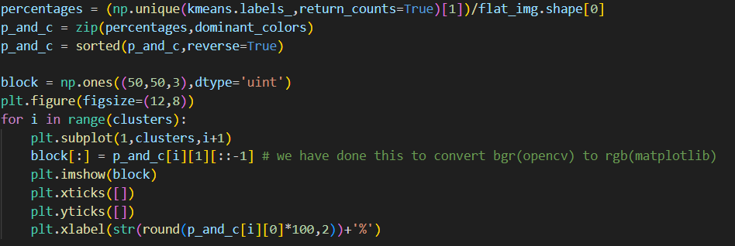
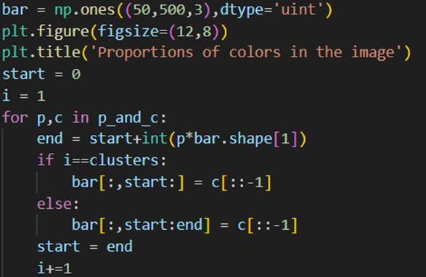
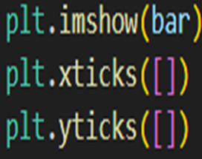
Plotting

Slide 14
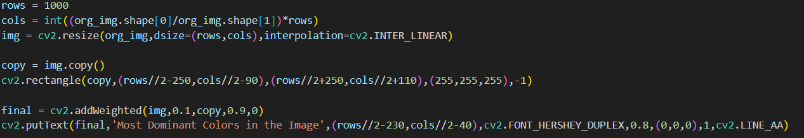
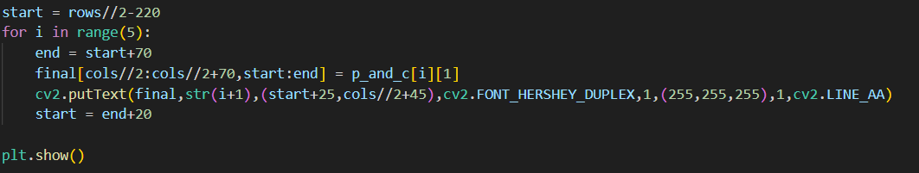
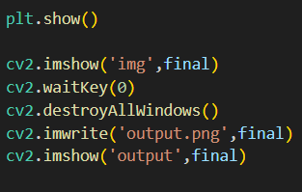
Plotting

Slide 15
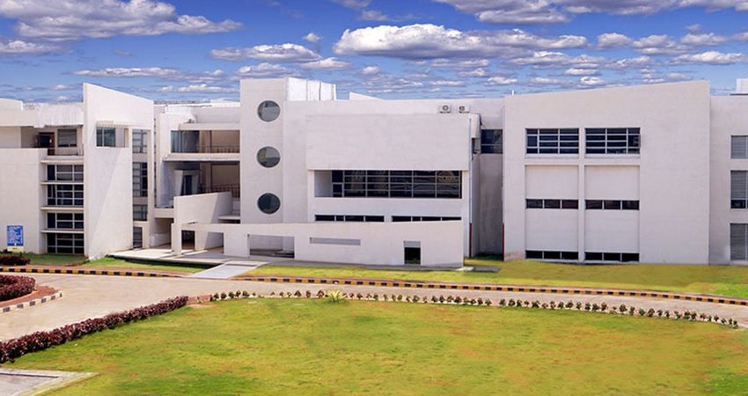

Input

Slide 16
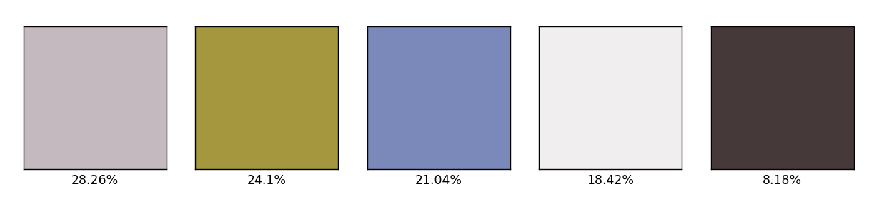
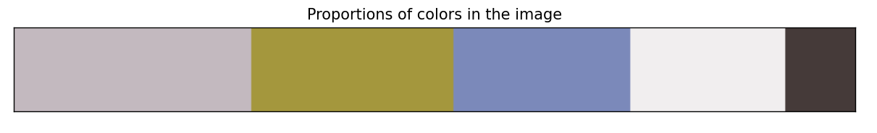
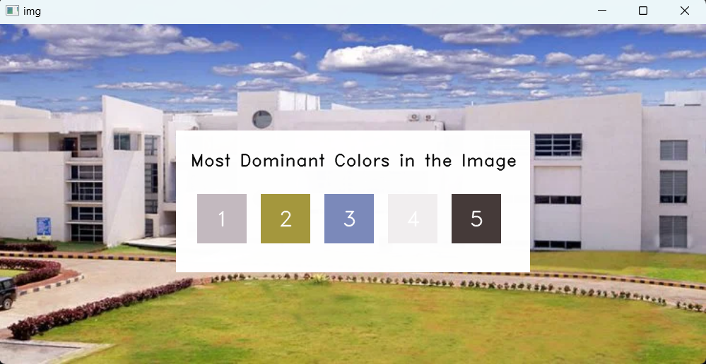
output

Slide 17


Slide 18


